Slide 1
Introduction to Docker

Slide 2
Agenda
What is Docker?
Container story
VMs vs. containers
What problem Docker solves
Docker for Windows
Docker Hub
Dependency management
Docker lifecycle
Docker File
Docker security
Summary

Slide 3
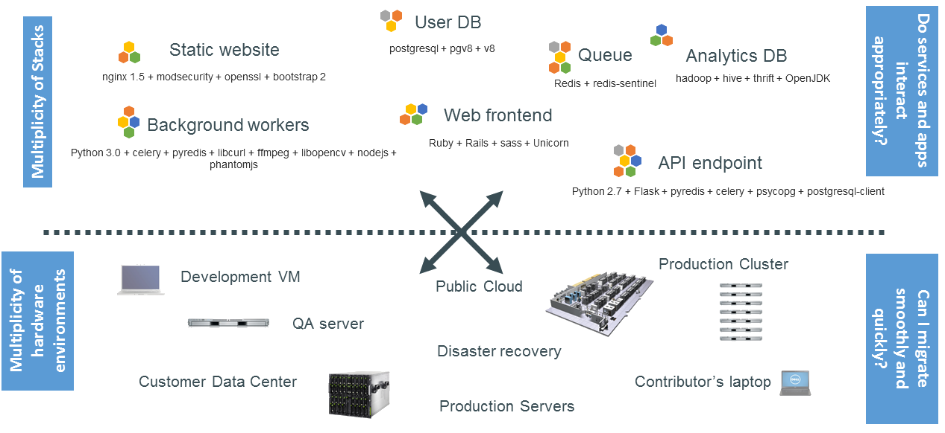
The challenge in IT world

Slide 4
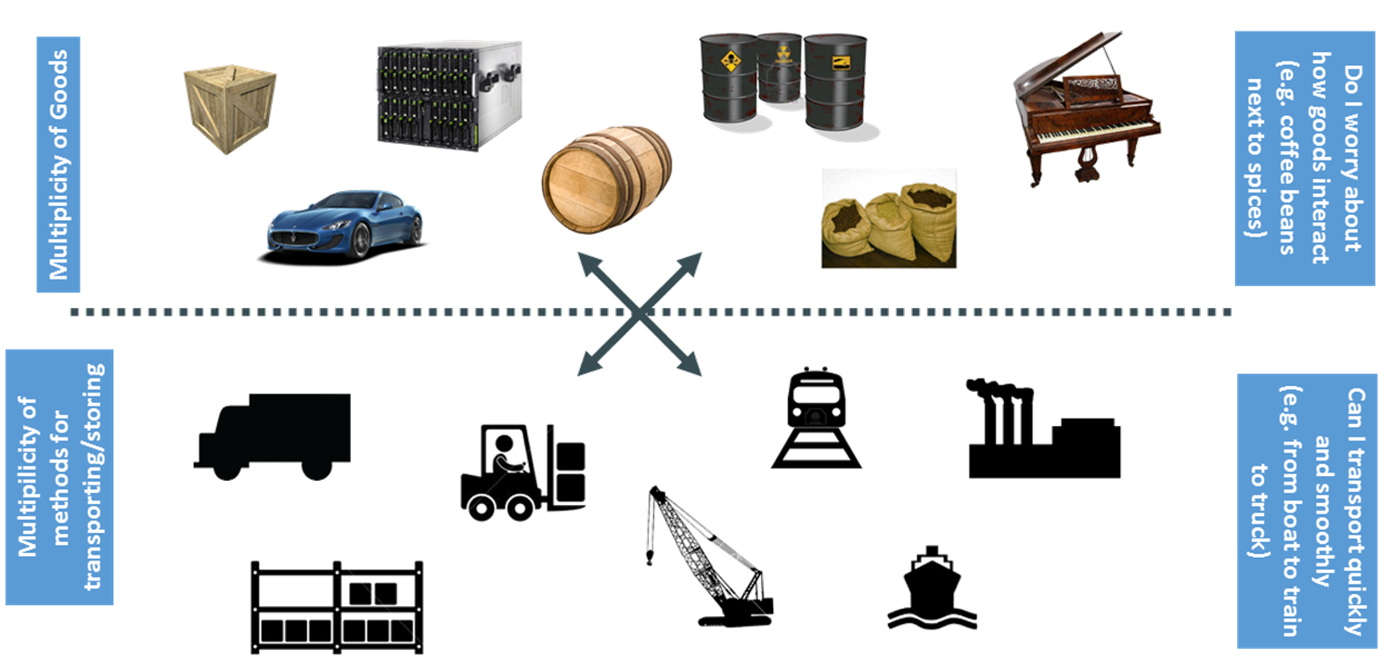
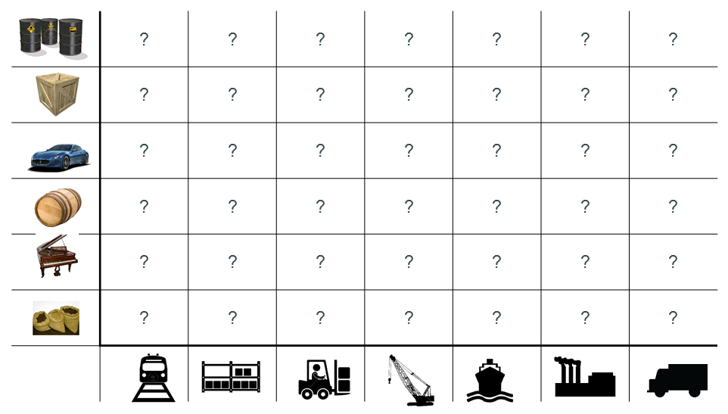
Container Story
Notes:
While transporting goods from home to destination , the goods may get damaged and lost while . So put all the goods in the container and don’t worry about the transport mode.

Slide 5
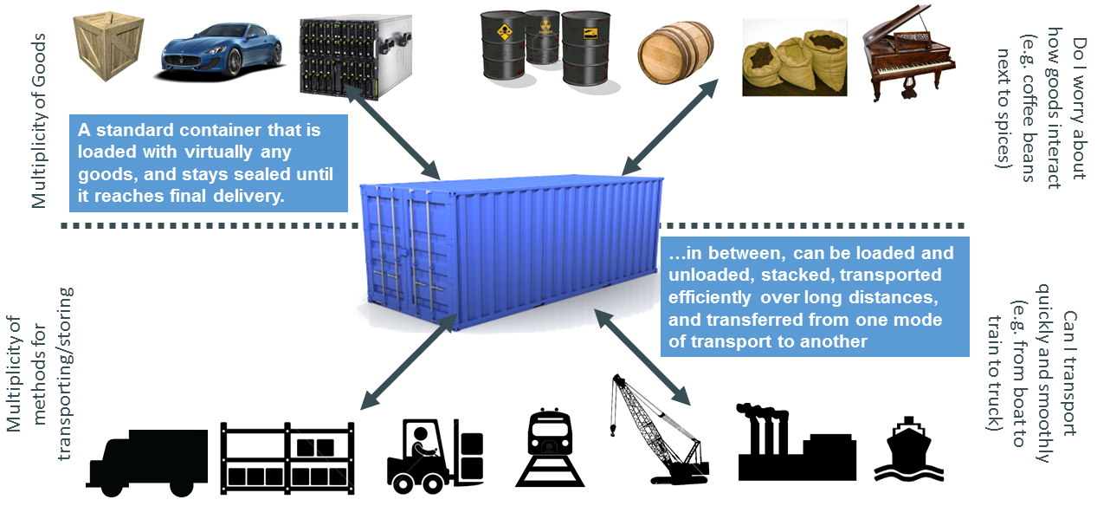
Invention: shipping container

Slide 6
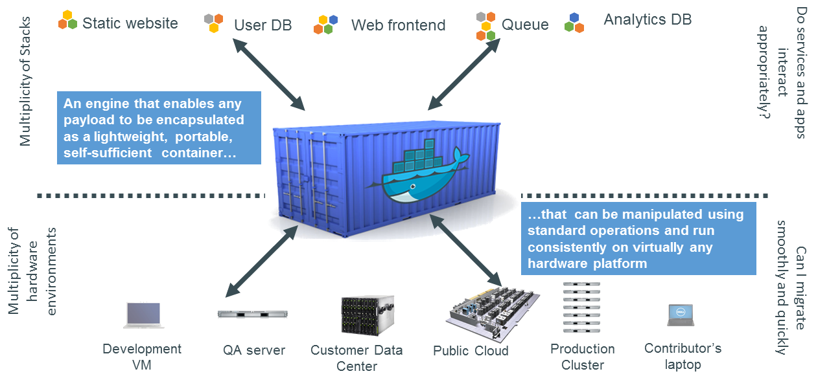
Docker is container system for code

Slide 7
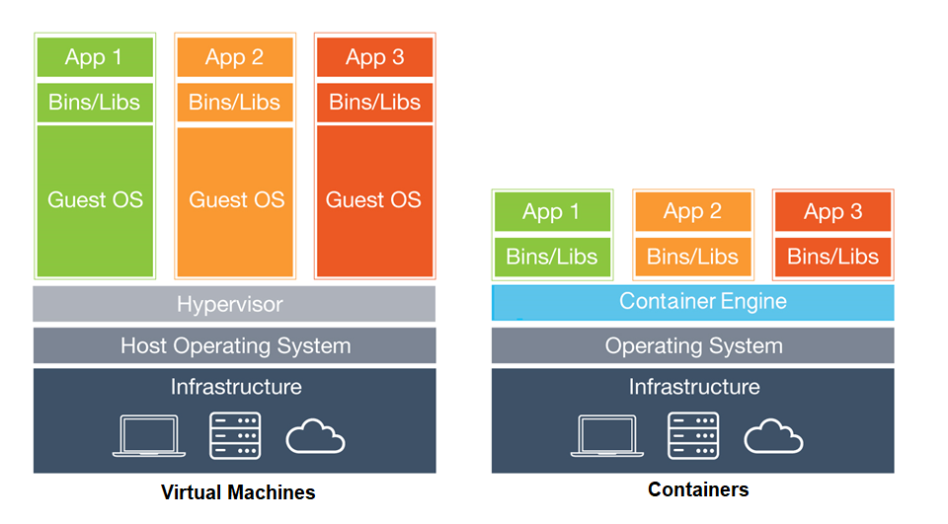
VMs vs. containers

Slide 8
VMs vs. containers cont.…
VMs | Containers
Heavyweight | Lightweight
Each VM runs in its own OS | Containers share the host OS
Hardware-level virtualization | OS-level virtualization
Startup time in minutes | Startup time in milliseconds
Allocates required memory | Requires less memory space
Fully isolated and hence more secure | Process-level isolation, possibly less secure

Slide 9
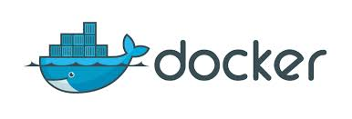
What is Docker?
Docker is an open platform for developers and system admins to build, ship, and run distributed applications.
It consists of:
Docker Engine :lightweight and powerful open source containerization technology combined with a work flow for building and containerizing your applications.
Docker Hub: SaaS for sharing and managing your application stacks.
Docker gives developers the ability to package an application with all of its dependencies included and in a single image that can run on any supported operating system.

Slide 10
What problem Docker solves
It solves the friction between the development , QA and production environments.
Ability of the Docker container to run on any platform.
Easy to migrate to different platforms.
Can utilize all available servers to run workloads.
Overcomes the hypervisors license cost and installation overhead.
Ability to run an application with different sets of software on the same host.
Better utilization, more portable, shared operating system

Slide 11
Docker for Windows
Docker is a full development platform for creating containerized apps, and Docker for Windows is the best way to get started with Docker on Windows. Download and install Docker for Windows from here.
Test your installation
Open a terminal window (Command Prompt or PowerShell, but not PowerShell ISE).
Run docker --version to ensure that you have a supported version of Docker:
> docker --version
Explore the Docker help pages by running some help commands
> docker --help
> docker container --help
> docker container ls --help
> docker run --help

Slide 12
Docker Hub
Docker Hub (hub.docker.com) is a cloud registry service for sharing application and automating workflow.
Major features:
Public and private Docker repositories
official Repositories
Collaborators, Organizations and Groups
Automated builds
you can push and pull container images to/from the Docker registry, which is something like a “GitHub” for Docker container images.

Slide 13
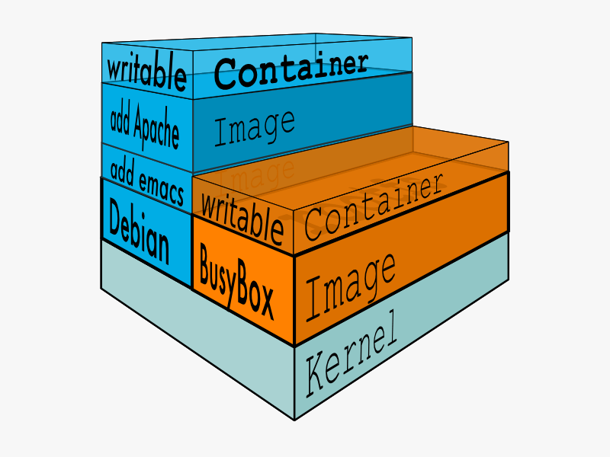
Dependency management
Docker provides a means to package and application with all its dependencies into standardized unit for software Development It provides isolation, so applications on the same host and stack can avoid dependency conflict It is portable, so you can be sure to have exactly the same dependencies at runtime during development, testing and in production

Slide 14
Docker lifecycle
Conception
BUILD an Image from a Dockerfile
Birth
RUN (create+start) a container
Reproduction
COMMIT (persist) a container to a new image
RUN a new container from an image
Sleep
KILL a running container
Wake
START a stopped container
Death
RM (delete) a stopped container
Extinction
RMI a container image (delete image)

Slide 15
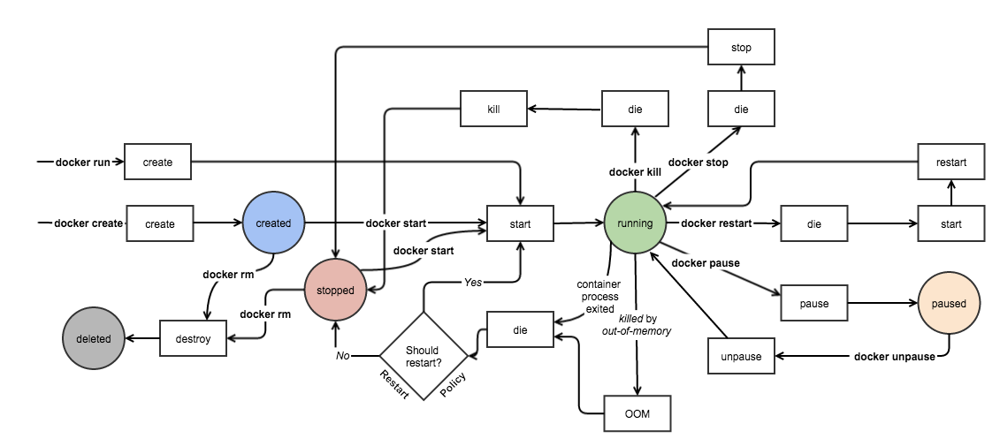

Slide 16
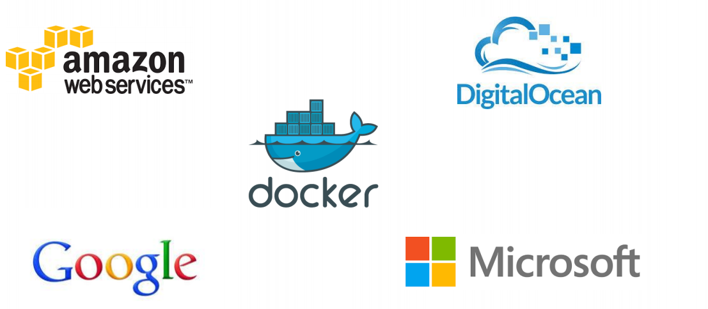
Docker supported in many Cloud platforms

Slide 17
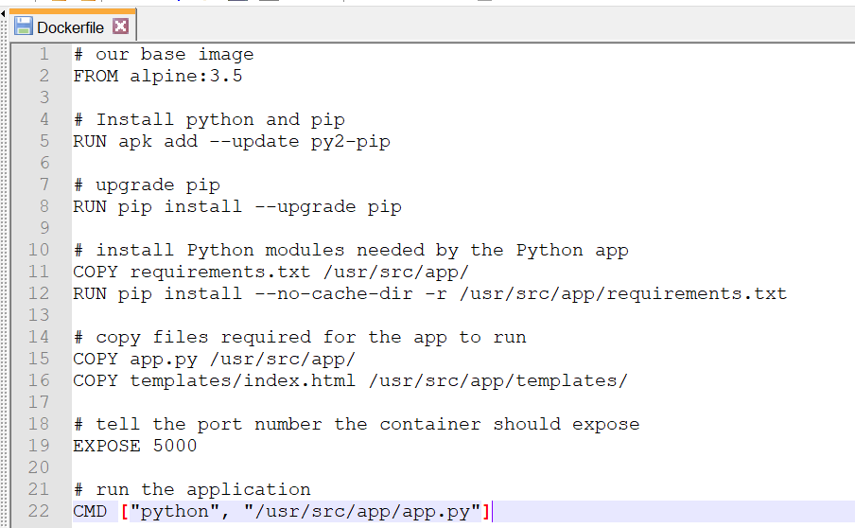
Docker File
Extends from a Base Image
Results in a new Docker Image
Docker file lists the steps needed to build an images
Docker build is used to run a Docker file
Can define default command for Docker run, ports to expose, etc

Slide 18
Docker security
"Containers managed by Docker are effective in resource isolation. They are almost on par with the Linux OS and hypervisors in secure operations management and configuration governance."
Another way of saying that is the server memory allocated to one container won't end up inadvertently being used by another container, and the same goes for other resources. That is, if the container formatting system sets logical limits and boundaries, they will be enforced by the Docker system.

Slide 19
Summary
Easy to build, run & share containers
Rapidly expanding ecosystem
Better performance vs. VMs
Layered file system gives us git-like control of images
Interesting facts
Google is offering container optimised VM.
Google spins 2 billion containers every week for executing their workloads.

